Slide 1
Assessing and Minimizing the Risks from Hazards
Lecture 08
Syeda Farwa Rizvi

Slide 2
Risk
ISO 45001 defines the term risk as “the effect of uncertainty”.
Risk is often expressed in terms of a combination of the severity and consequences of an event (including changes in realities) and likelihood or occurrence.
Risk is commonly a multiple of severity and occurrence (Risk = Severity x Occurrence).

Slide 3
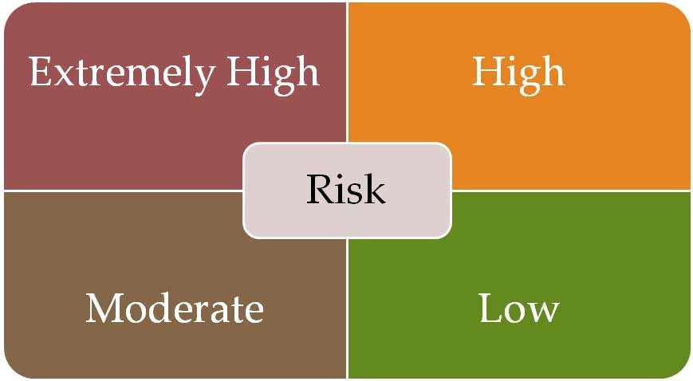

Slide 4
Occurrence is the frequency of the event that is expected.
Severity is the impact of the hazard when or if it occurs. Severity, from an OH&S perspective, can be fatal, a disability, a first aid case, or a near miss.

Slide 5
Incidents and Accidents
ISO 45001 defines the term incident as “occurrence arising out of, or in the course of, work that could or does result in injury and ill health”. Examples of incidents are accidents and near-miss reports.
An incident where injury or ill health occurs is referred to as an accident.
Within accidents there are: fatalities, disabilities, asset damage, first aid cases and injuries etc.
An incident where no injury or ill health occurs, can be referred to as a “near-miss”, “near-hit” or “close call”.
Although there may be nonconformity related to an incident, incidents can occur where there is no nonconformity.

Slide 6
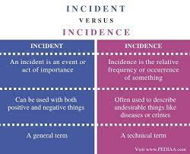
incident | Accident
An “incident” is any unexpected event that does not result in serious losses or injury | an “accident” is an unexpected event that causes damage, injury, or harm

Slide 7
Risk Assessment
It is a 5 steps process
1. Look for hazards.
2. Decide who might be harmed and how.
3. Evaluate the risks and decide whether the existing precautions are adequate or whether more should be done.
4. Record your findings.
5. Review how successful the assessment and revise if necessary.

Slide 8
Risk Estimation
The effect of a hazard may be rated:
3 Major----------death or major injury;
2 Serious –– injuries cause worker to be work for 3+ days;
1 Slight–– all other injuries –– not serious. Little time off work.

Slide 9
The likelihood of harm may be rated:
3 High –– where it is certain or near certain that harm will occur;
2 Medium –– where harm will occur frequently
1 Low –– where harm will seldom occur.

